Slide 1
Mobile Solution for Employee Protection at Work How to save money and gain the productivity?
Tomislav Bronzin, Microsoft Regional Director and MVP

Slide 2
About Tomislav Bronzin Microsoft Regional Director & Most Valuable Professional
Software Architect – CITUS Ltd.
Consultant and trainer on .NET architecture and development, http://www.citusgrupa.com
INETA Europe Vice President http://europe.ineta.org
One of the leaders of MS Community in Europe
Recent projects:
Protect@Work, Competence Manager, Smarthome,
Speaker:
TechEd Europe, DevDays , DevReach, WinDays, Sinergija, NT Konferenca, Vizija
Contact at tomislav.bronzin@citus.hr

Slide 3
Protect@Work
“Advanced ICT solution for safer workplace!”
Protect@Work enables companies efficient implementation of labor welfare and security measures with seamless monitoring!
BUSINESS
CHALLANGES
SOLUTION
RESULTS
Obligation by law: secure working conditions
Huge paperwork and track records
Distributed data entry
Field work
Timely warnings and escalations
Advanced ICT system enabling:
planning and assignment
tracking and alarming
reporting and archiving
of employees’ personal safety equipment data
Reduced injuries
Regulatory compliance
Reduced costs of
equipment purchasing
sick leave
compensations for injuries
insurance costs

Slide 4
Agenda
Story about P@W (motivation)
Why protection at work is important, especially in the field work?
Architecture of Mobile Solution for P@W
Example of user scenario
Possible future – Silverlight on Win Mobile
With DEMO!
Case study – Croatian Forests (10k workers)

Slide 5
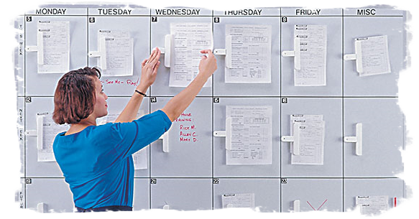
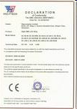
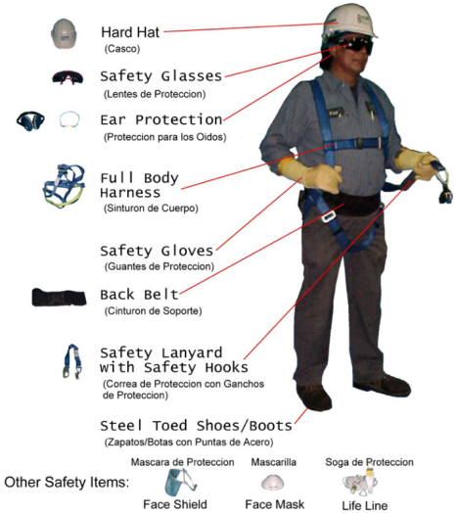
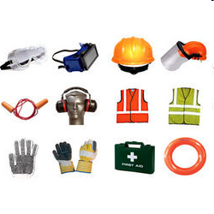
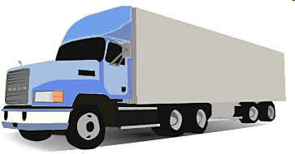
Data Retrieval
JOB ASSIGNMENTS
certificates
specializations
qualifications
WAREHOUSE
HR
ERP
db
SUPPLIERS
LAWS AND
REGULATIONS

Slide 6
Who is it for?
Forest and water management
Utilities: gas, oil, electricity
Production industry
Turism
Road management
Civil engineering
Telecommunication
Airports
Commerce
Agriculture
ICT companies

Slide 7
Protective equipment (for example: Boots)
Job description
Protective equipment (for example: jacket)
Working place
Job description
.
.
.
Working place
Job description
.
.
.
.
Protective equipment (for example: glows)
Working place
.
.
.
Job description
Working place

Slide 8
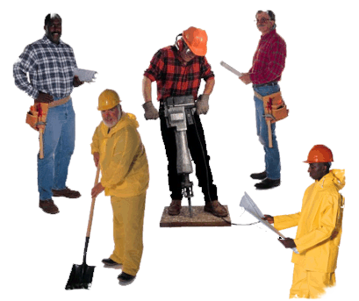
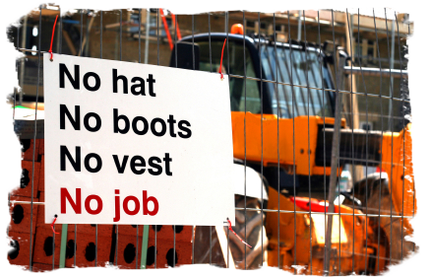
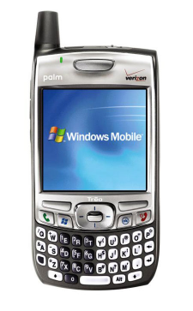
Mobile Access & Control

Slide 9
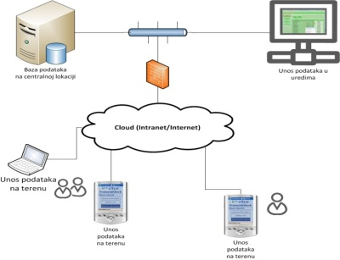
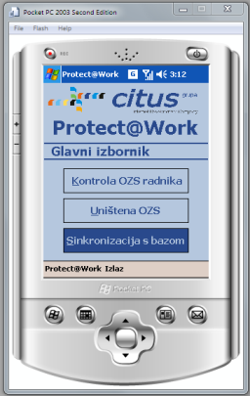
Architecture

Slide 10
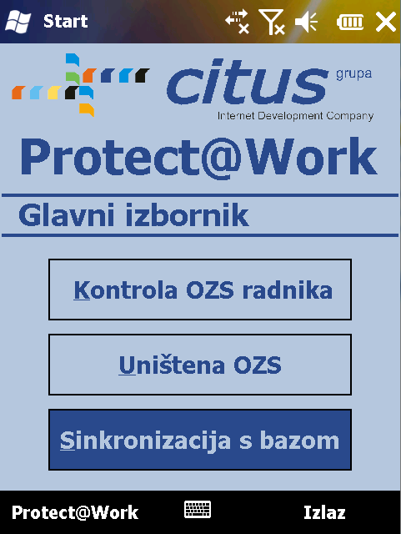
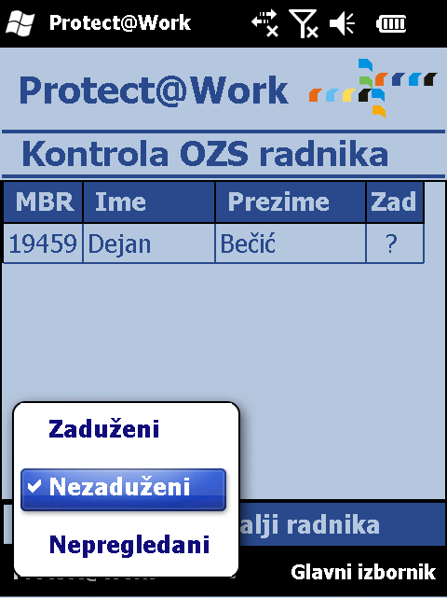
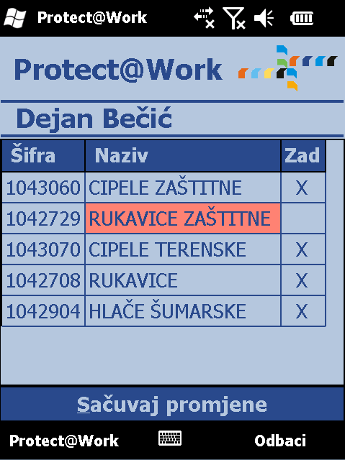
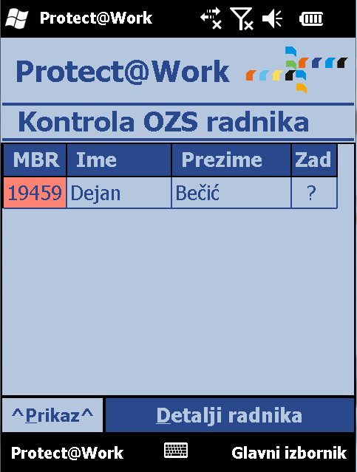
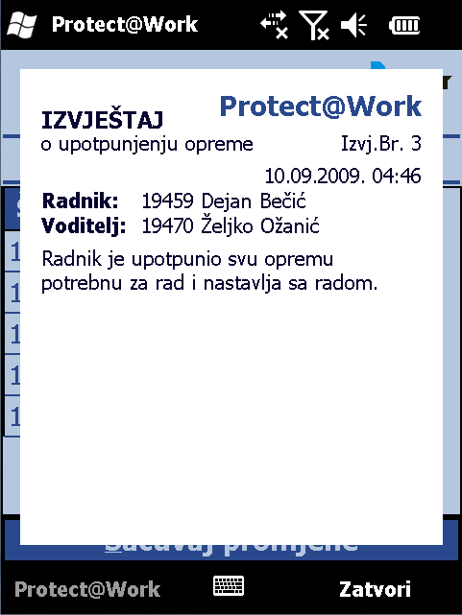
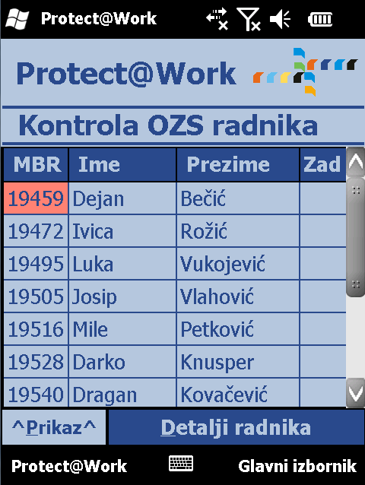
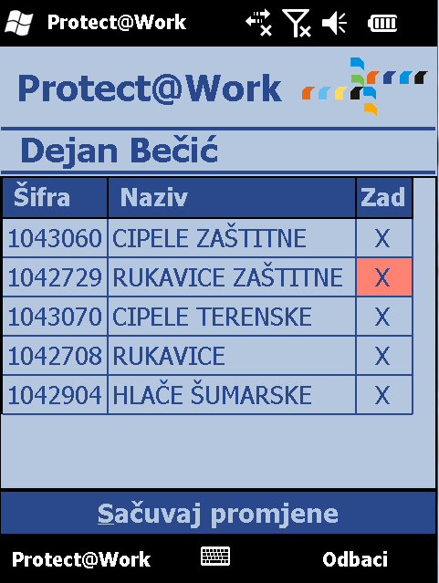
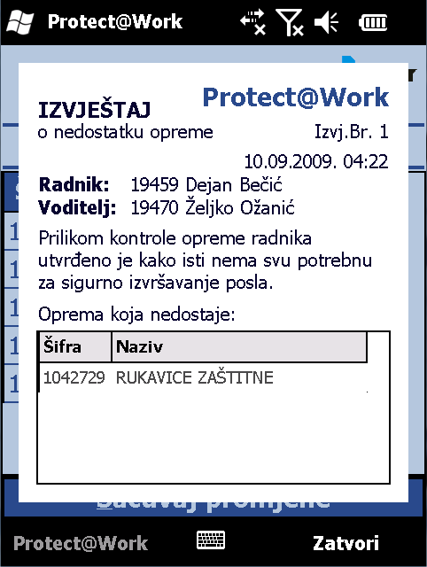
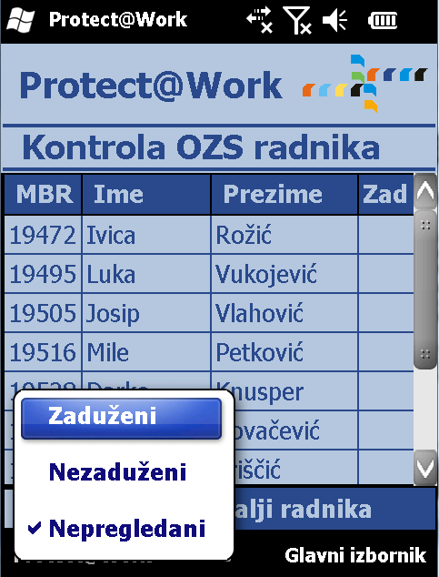

Slide 11
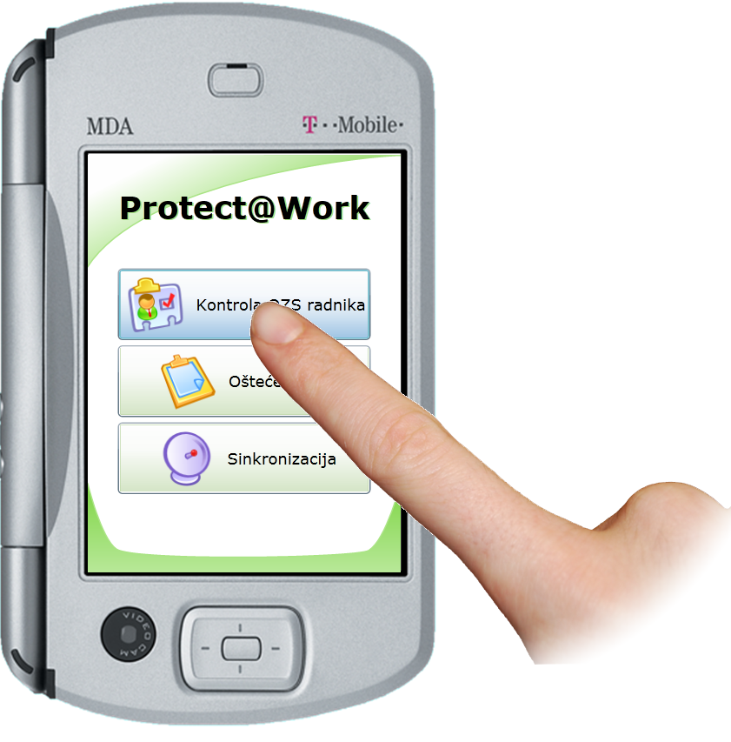
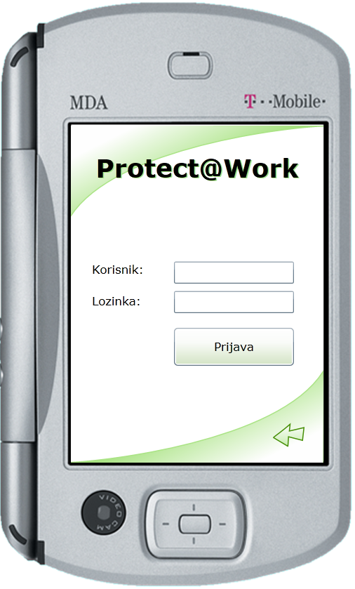
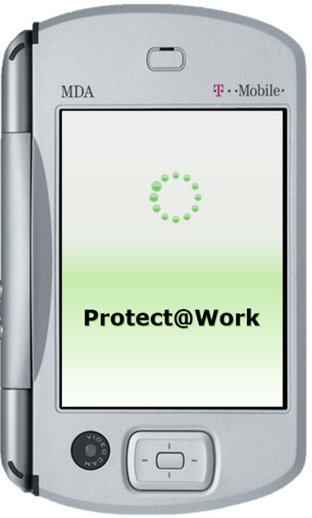
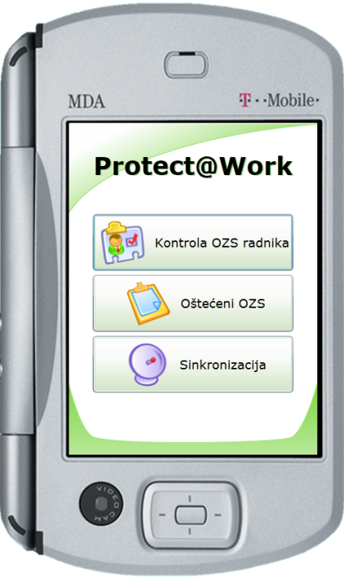
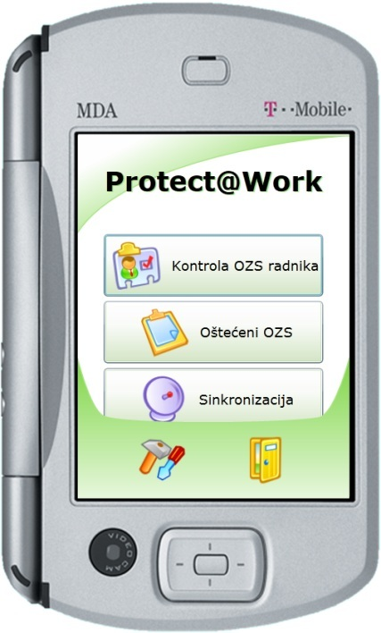
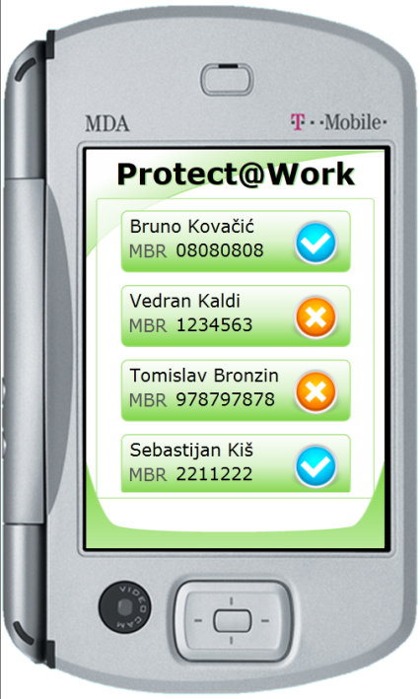
Where is future?
Gestures instead using buttons, stylus and keyboards
Silverlight on mobile devices
Windows Phone 7 Series
Demo – Silverlight UI

Slide 12
Case Study: Croatian Forests
Before:
on average 14 fatal casualties at work per year + many injuries
higher insurance costs
absence from work due to sick leave huge paperwork
high costs for replacement manpower, education
bulk ordering of the equipment
poor record of usage
strange wear-out patterns
After:
0 dead in the last 2 years and much less injuries
lower insurance costs
reduced absence from work
less paperwork, automated process and easier communication
exact ordering per employee
reduced frequency or reordering (tracking of usage of the equipment)
control of usage

Slide 13
Technical Information (1)
Customizable GUI
Branding of the GUI
Localization to local language (Multilanguage features)
Support for Windows Mobile OS
Unified communications
Sending and receiving ofg SMS, e-mail, voice calls
Integration with Microsoft Office Exchange
Integration with Microsoft Communication Server
Integration with Cisco Unified Communications Manager
Notes:
Customizable GUI
Branding of the GUI
Localization to local language (multilanguage features)
Support for Windows 7, Windows Mobile
Unified communications
SMS, e-mail, voice calls
Integration with Microsoft Office Communication Server
Integration with Microsoft Exchange
Integration with Cisco Unified Communications Manager
Asynchronous data communications – works over GPRS
API for integration with software modules for
Human Resource Management
ERP (Navision, SAP, legacy solutions…)
Warehouse
Business Intelligence
Document management
Supports bar-coding/scanning of equipment items, fast and easy compliance checks
Supports hierarchy models of large organizations and hosted service model
Enables geo-location of expensive equipment items and personnel

Slide 14
Technical Information (2)
Asynchronous data communications - better UI
Works even on slow communication lines
like GPRS / EDGE
Programing interface (API) for integration with other software packages/modules for
Human Resource Management, ERP (Navision, SAP …)
Supports bar-coding/scanning
of equipment items, fast and easy compliance checks
Supports hierarchy models of large organizations
Enables geo-location of personnel/equipment
Notes:
Customizable GUI
Branding of the GUI
Localization to local language (multilanguage features)
Support for Windows 7, Windows Mobile
Unified communications
SMS, e-mail, voice calls
Integration with Microsoft Office Communication Server
Integration with Microsoft Exchange
Integration with Cisco Unified Communications Manager
Asynchronous data communications – works over GPRS
API for integration with software modules for
Human Resource Management
ERP (Navision, SAP, legacy solutions…)
Warehouse
Business Intelligence
Document management
Supports bar-coding/scanning of equipment items, fast and easy compliance checks
Supports hierarchy models of large organizations and hosted service model
Enables geo-location of expensive equipment items and personnel

Slide 15
Summary – Business Info
Saving lives
foreman on the field can check whether worker has compliant equipment for the job assignment
reduced injuries due to proper safety equipment
Savings on insurance
track record for insurance in case of incident
less compensations for injuries
over time reduced insurance costs
Savings on purchasing
ordering exactly what is needed (for each employee)
ordering according to equipment wear-out period (calculating sick leave, vacations, and when it was actually used, based on job assignment)
Regulatory compliance

Slide 16
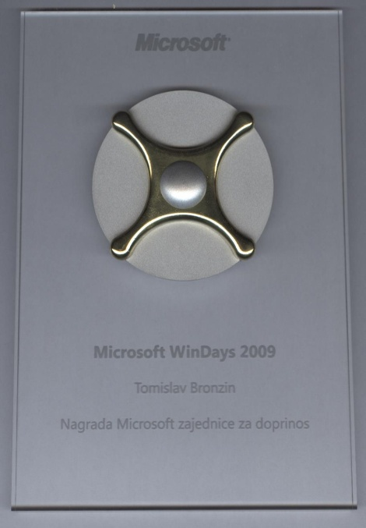
Awards and contact info:
www.protectatwork.com/en
helpdesk@citus.hr
British Invention Show: Silver medal

Slide 17
Questions?

